Slide 1


Force Fitness Program Overview FFI SSgt Baker A. E.

Slide 2
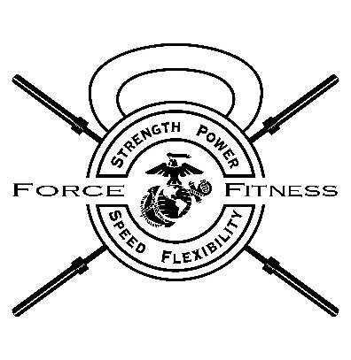
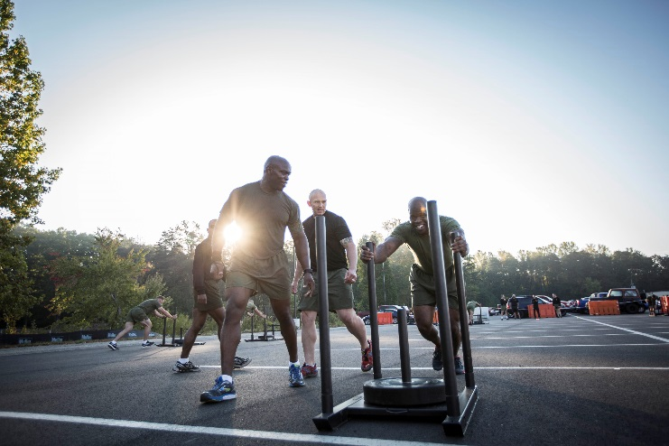
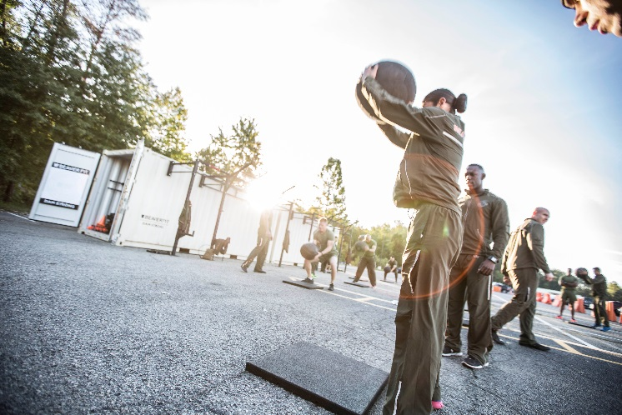
Why the need for a Force Fitness Program?
“…to be ready to fulfill our role as the Nation’s force-in-readiness, we require Marines who are smart, fit, disciplined, resilient, and able to adapt to uncertainty and to the unknown”
-MARADMIN 621/16

Slide 3

The Role of the Force Fitness Program
Principles of a well designed progressive program which need to be applied
- Prevent potential for injury
*Address flexibility issues
*Proper nutrition strategies
*Aid in recovery, regeneration and prevention
-Increase performance which will
transfer to a tactical situation
-Builds strength, mobility, and speed
Notes:
*The 37th CMC recognized a problem within the Marine Corps as far as physical fitness. We have instructors for everything from rifle, swim, mcmap, MOS, Academy, etc., but we don’t have any subject matter experts in the field of physical fitness- an activity that Marines participate in corps wide on a daily basis.
*Insufficient knowledge has lead to ineffective training and increases in preventable injuries
*TECOM has developed the force fitness program which specializes in individual unit fitness programming that will be lead by the Force Fitness Instructor
*Force Fitness programming will aid each individual unit in achieving their specific METLs by training the Marines smartly which will, in turn, translate into a tactical situation on the battlefield.

Slide 4
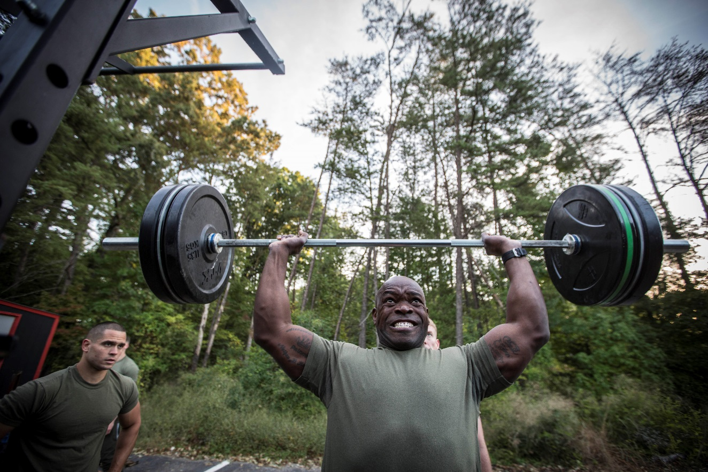
The Role of the Force Fitness Instructor
Subject matter expert in developing a unit physical fitness program
Unit Specific based on METLs
Reflective of TEEP
Utilizing risk assessment and
management
Including phases of strength,
speed, flexibility, and mobility
development
Notes:
*The force fitness instructor will return to their units and act as an advisor to the Commanding Officer on the areas of unit physical fitness programming’
*The FFI will develop a program that will cater to the unit’s TEEP, taking into account the units mission.
*The program will include specialized periodization training that will encompass the different phases of strength, speed, flexibility and mobility development
-The program will allow for smart progressive training in order to manage risk

Slide 5
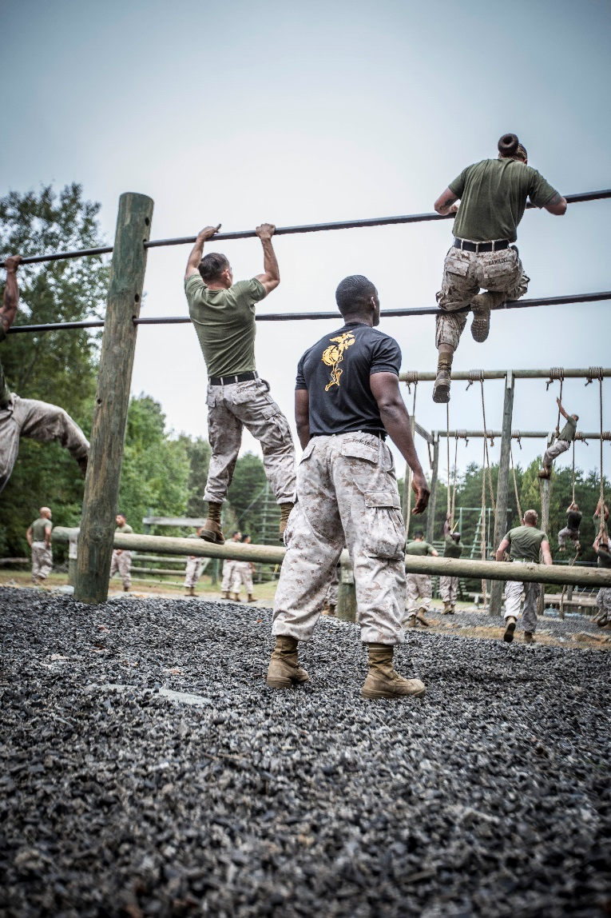
The Role of the FFI (cont.)
Assisted by unit CPTRs with:
-PFT/CFT monitoring and completion
-BCPMAP monitoring and enforcement
Provide Individual coaching and guidance to Marines
- BCPMAP guidance
- Individualized nutrition and fitness plans
- Provide minor injury recovery assistance
Notes:
*The FFI will be assisted by the unit CPTR in conducting and certifying PFT and CFTs
*The FFI will be able to offer individualized guidance to Marines within the unit with matters concerning fitness, nutrition, and overall wellness.
-This will include nutrition plans and individualized training programs
-Fitness plans will be catered to any pre-existing or current injuries
*The FFI will be able to offer minor rehabilitation to Marines that are suffering from current or past injuries

Slide 6
The Role of the Command
POLICY LETTER 1-17
Situation. Physical fitness is an essential component of Marine Corps combat readiness. Every Marine and sailor must be physically fit regardless of age, rank, or billet. Physical fitness must be an integral part of every Marine and sailor’s character as it is inherent to the Marine Corps’ way of life. Furthermore, Marines and sailors who do not meet the Marine Corps’ physical fitness requirements are a detriment to their unit and detract from combat readiness
Coordinating Instructions. Unit leaders preparing to lead physical training are encouraged to seek guidance from a Marine FFI in order to prepare the morning routine of physical training. Training will encompass a dynamic warm-up, an event specific warm-up, event, and flexibility training in order to accomplish a well-rounded training session
Notes:
This slide will contain the mission statement on physical fitness from the student’s unit and the commanders intent.

Slide 7
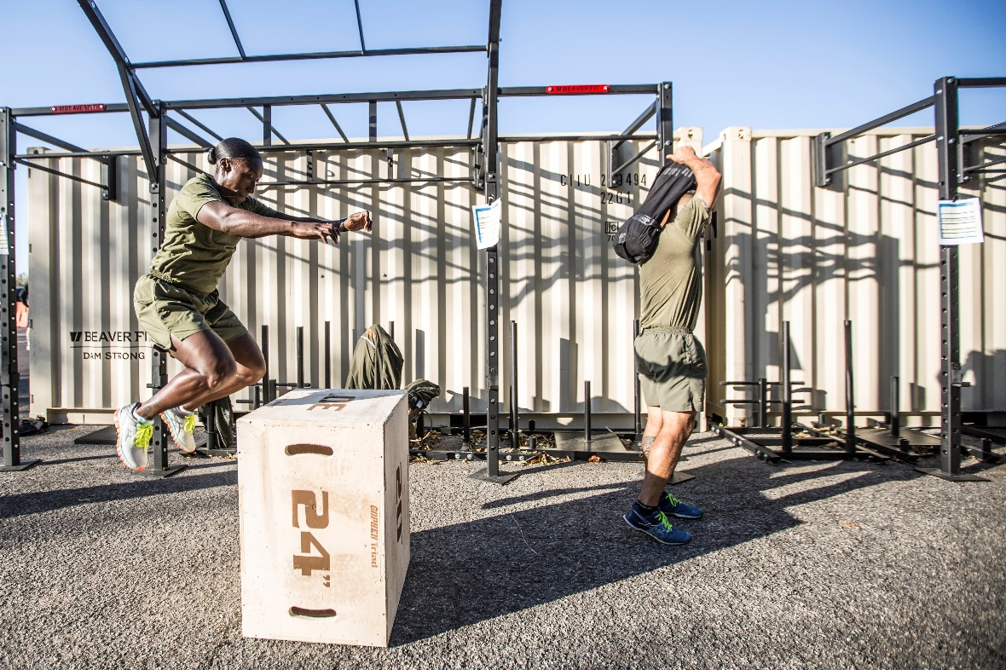
The Role of the Command
Embrace program and influence adaptation
Select appropriate Marines to attend training and carry out billet responsibilities
- Possess maturity, commitment,
leadership qualities
- Ability to lead and instruct
- Maintain physical and mental fitness
Notes:
(This slide will state how exactly the FFI will be able to enforce the commander’s intent)
*The command must embrace the commandant’s directive and aid in influencing the unit to follow suit.
*The command must ensure to send competent Marines through the FFIC
-Prereqs. (maintain elite physical fitness)
-Mature
-Ability to lead and instruct

Slide 8
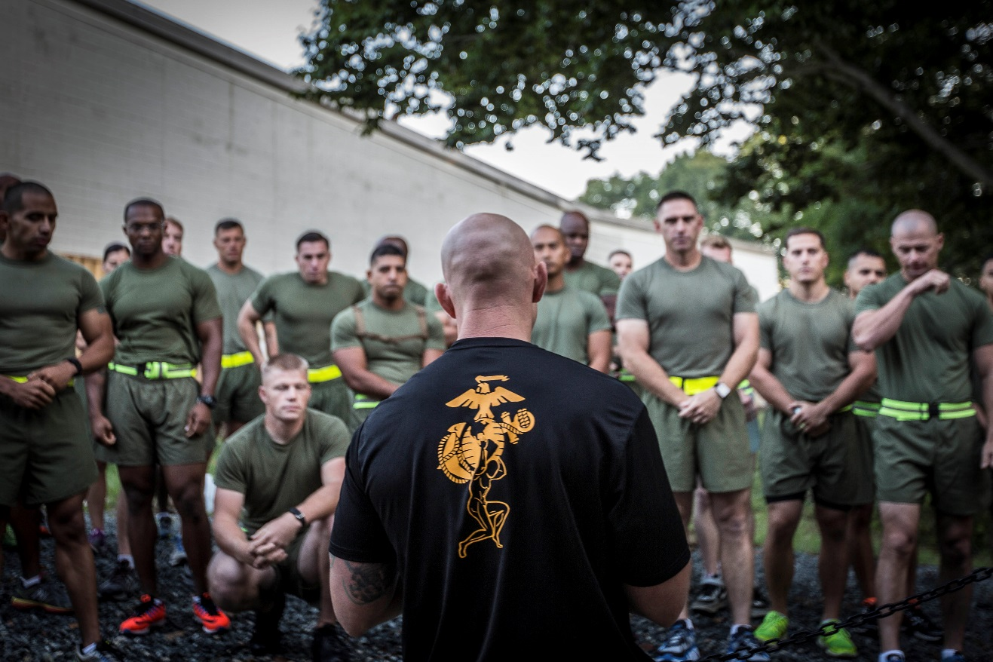
References
*MARADMIN 621/16
*MCO 6100.13 w/Ch2
*MCO 6110.3A
*Fitness.Marines.mil
Notes:
MARADMIN 621/16 - MARINE CORPS PHYSICAL FITNESS PROGRAM AND THE ROLE OF THE FORCE FITNESS INSTRUCTOR
MCBULL 6100 - MARINE CORPS PHYSICAL FITNESS AND COMBAT FITNESS TESTS
MCO 6100.3A - MARINE CORPS BODY COMPOSITION AND MILITARY APPEARANCE PROGRAM

Slide 9
Questions?

